Slide 1

Knowledge-Based System Engineering
Ratih N.E Anggraini, Ph.D
Intelligent Information Management Lab

Slide 2
Semester Learning Plan
1. Introduction to KBS
7. RDF and OWL
9. Semantic Network
10. Graph (Neo4j)
2. Propositional Logic
3. First Order Logic
5. Ontology
6. DL for Ontology
4. Demo Assignment on FOL
8. Demo on RDF assignment
11. Demo on Neo4j Assignment
12. FP topic presentation
13. Written Exam
14. Enrichment (Research on KBS)
15. FP Demo
16. FP Revision

Slide 3
Introduction to Knowlegde-based System Engineering
Knowledge-based System Engineering
Intelligent Information Management Lab

Slide 4

Can computer “understand” data?
Temperature = 39°C
SpO₂ = 89%
Cough = TRUE
Dyspnea = TRUE
What this data means for computer?

Slide 5
Why knowledge-based system?
Data alone is not enough
A Knowledge-Based System needs:
Concepts
Relationships
Rules
Constraints
Inference mechanisms
39°C
89%
Cough = TRUE
↓
???
↓
KNOWLEDGE
What can we infer?

Slide 6

Knowledge-based System

Slide 7
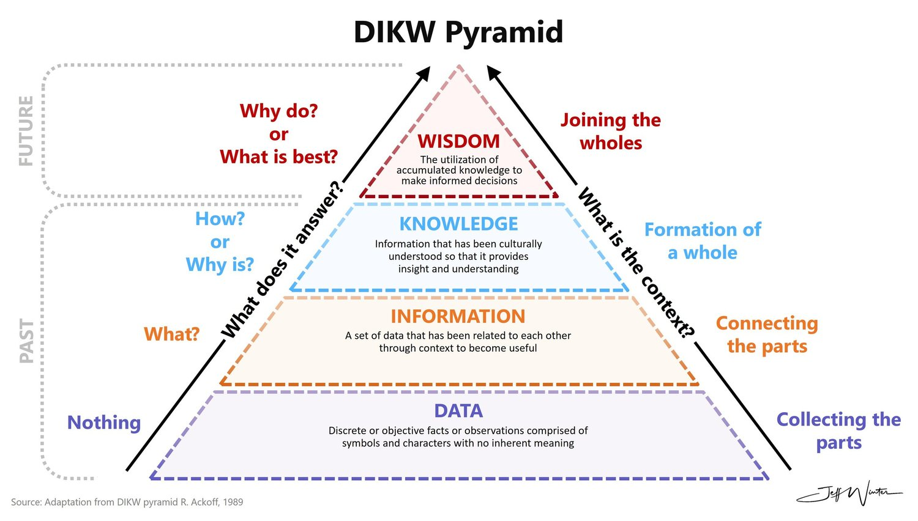

Slide 8
DIKW Example
Level | Example
Data | Temperature = 39°C
Information | Patient has high temperature
Knowledge | Temperature > 38°C → Fever
Wisdom | Prioritize appropriate clinical assessment

Slide 9

Class Activity
Can you find another example?
Notes:
Case study: Weather, Road closing

Slide 10
Knowledge Engineering Activities
Knowledge acquisition involves obtaining knowledge from various sources including human experts, books, videos and existing computer sources of data such as databases and the Internet.
In knowledge validation, knowledge is checked using test cases for adequate quality.
Knowledge representation involves producing a map of the knowledge and then encoding this knowledge into the knowledge base.
Inferencing means forming links (or inferences) in the knowledge in the computer software so that the KBS can make a decision or provide advice to the user.
Explanation and justification involves additional computer program design, primarily to help the computer answer questions posed by the user and also to show how a conclusion was reached using knowledge in the knowledge base.

Slide 11

Problems and
Challenges
Complex information and knowledge is difficult to observed

Slide 12

Problems and
Challenges
Complex information and knowledge is difficult to observed
The experts have different background and resources

Slide 13

Problems and
Challenges
Complex information and knowledge is difficult to observed
The experts have different background and resources
Various representations:
    Textbooks, Graphical representations, Heuristics, skills

Slide 14
Knowledge Based System (KBS)
Knowledge-based systems are computer programs that are designed to emulate the work of experts in specific areas of knowledge.
A KBS can perform many of the tasks undertaken by humans with some limitations
  KBSs are uninspired and developed for fixed purpose
  KBSs are focused on a particular problem and cannot be used for other problems
  KBSs are limited to the technical knowledge that has been built into them

Slide 15

The importance of Knowledge Engineering
Knowledge is valuable and often more stays longer than the system, thus, we need Knowledge management
Mistakes in knowledge-base can cause serious problems
Knowledge is easily evolved so knowledge management has to be able to facilitate this change

Slide 16
Types of KBS
Expert Systems
Neural Networks
Case-based Reasoning
Intelligent Agents
Data Mining
Genetic Algorithm

Slide 17
Modelling The Real World
Knowledge-based System Engineering

Slide 18
Principles of Real World Modeling
Entity
What exists?
Attribute
What describes it?
Relationship
How are things connected?
Taxonomy
How are concepts classified?
Constraint
What must or must not be true?
Any objects, concepts, process
The characteristics of the entity
Something that connect two entity
Hierarchy of generalization/specification
Any condition that must be followed

Slide 19
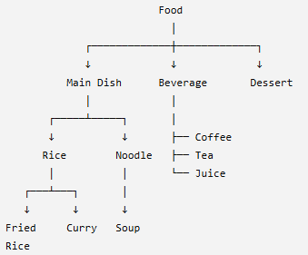
Modeling Example
Case study: Food Delivery
Entities:
Customer
Restaurant
Food
Order
Payment
Delivery
Driver
Attributes:
Customer
-------------
customerID
name
phone
Address
Relationship:
places(Customer, Order)
contains(Order, Food)
offers(Restaurant, Food)
paidBy(Order, Payment)
deliveredBy(Order, Driver)
Taxonomy
Constraints:
Food.price > 0
Order.contains ≥ 1 Food

Slide 20
Class Activity
Can you find another modeling example?
Notes:
Case study: University academic process

Slide 21
Knowledge Representation
Knowledge-based System Engineering

Slide 22
Definition of KR
"KR is the bridge between human understanding and machine computation."
Knowledge Representation (KR) is the field of AI concerned with how knowledge about the world can be symbolically represented in a way that enables automated reasoning, inference, and decision-making by machines.
Why KR Matters
Enables intelligent behavior in AI systems.
Supports explanation, consistency checking, and reuse.
Critical for expert systems, semantic web, robotics, and NLP.

Slide 23
Type of KR
Knowledge | Representation
Facts & propositions | Logic
Concepts & relationships | Semantic Network
Formal domain concepts | Ontology
Structured concepts | Frame
Event sequences | Script
Conditional knowledge | Rule-based
Uncertain knowledge | Probabilistic

Slide 24
Rule-based KR
IPS | Maximum Study Load
IPS < 2.50 | 18 SKS
2.50 ≤ IPS < 3.00 | 20 SKS
3.00 ≤ IPS < 3.50 | 22 SKS
IPS ≥ 3.50 | 24 SKS
RULE-BASED:
IF Program = Sarjana AND IPS < 2.50 THEN MaximumSKS = 18,
IF Program = Sarjana AND 2.50 <= IPS AND IPS < 3.00 THEN MaximumSKS = 20
IF Program = Sarjana AND 3.00 <= IPS AND IPS < 3.50 THEN MaximumSKS = 22
IF Program = Sarjana AND AND IPS >= 3.50 THEN MaximumSKS = 24

Slide 25
Frame KR
A frame represents knowledge about a particular concept, object, or situation using a collection of:
Slots → properties/attributes
Values → values of those properties
Facets → additional information about a slot, such as constraints, defaults, or procedures
FRAME: STUDENT
studentID → 12345
name → Ahmad
GPA → 3.72
semester → 6
department → Informatics
completedCredits → 108
Constraint:
GPA
TYPE: numeric
RANGE: 0..4
semester
TYPE: integer
RANGE: 1..14

Slide 26

Case Study 1: SNOMED-CT – Global Clinical Ontology
Domain: Clinical Terminology Standardization
KA Sources:
  Thousands of medical experts worldwide.
  Clinical guidelines, textbooks, EHRs, and specialty societies (e.g., WHO, NHS).
KR Formalism: OWL 2 (Web Ontology Language) + Description Logic (EL++).
References:
Cornet, R., & de Keizer, N. F. (2021). "Forty Years of SNOMED: A Review." Journal of Biomedical Informatics, 119, 103816.
SNOMED International. (2023). https://www.snomed.org

Slide 27

Case study 2: Semantic Web & Enterprise: DBpedia & Wikidata
Domain: Open Knowledge Graphs
KA Sources: Wikipedia infoboxes, categories, and structured content
KR Formalism: RDF (Resource Description Framework), RDFS, OWL.
References
Lehmann, J., et al. (2020). "DBpedia – A Large-Scale, Multilingual Knowledge Base Extracted from Wikipedia." Semantic Web, 11(1), 1–24.
Wikimedia Foundation. (2023). https://www.wikidata.org

Slide 28

Case study 3: Cybersecurity: MITRE ATT&CK Framework
Domain: Threat Intelligence & Incident Response
KA Sources:
  Real-world cyberattacks (e.g., SolarWinds, WannaCry).
  Security analysts, malware reverse engineers, dark web monitoring.
  Public reports (e.g., CISA, FireEye).
KR Formalism: Structured taxonomy (not full ontology), but semantically rich.
References
MITRE. (2023). MITRE ATT&CK® Framework. https://attack.mitre.org
Chen, J., et al. (2023). "Automated Construction of Cybersecurity Knowledge Graphs from Dark Web." Computers & Security, 124, 102983.

Slide 29

Case study 4:Agriculture: Crop Ontology (CO) by CGIAR
Domain: Smart Farming & Crop Science
KA Sources:
  Agronomists, plant breeders, field researchers.
  Crop databases (e.g., Genesys, GrainGenes).
  Research papers on drought resistance, yield traits.
KR Formalism: OWL-based ontology
References:
Shrestha, R., et al. (2021). "The Crop Ontology: Enabling Standardization of Crop Trait Data." Nucleic Acids Research, 49(D1), D1465–D1472.
https://www.cropontology.org

Slide 30
Case study 5: Law: LegalRuleML & CaseLaw Analytics
Domain: Legal Reasoning & Compliance
KA Sources:
  Legal experts, judges, regulatory bodies (e.g., GDPR, HIPAA).
  Court rulings, statutes, compliance guidelines.
KR Formalism:LegalRuleML, Deontic Logic, Ontologies
References
Governatori, G., et al. (2020). "Legal Knowledge Representation: A Survey." Artificial Intelligence and Law, 28(4), 457–489.
Boer, A., & Winkels, R. (2022). "Building Legal Knowledge Graphs from Case Law." Proceedings of JURIX 2022.

Slide 31
THANK YOU

